Slide 1
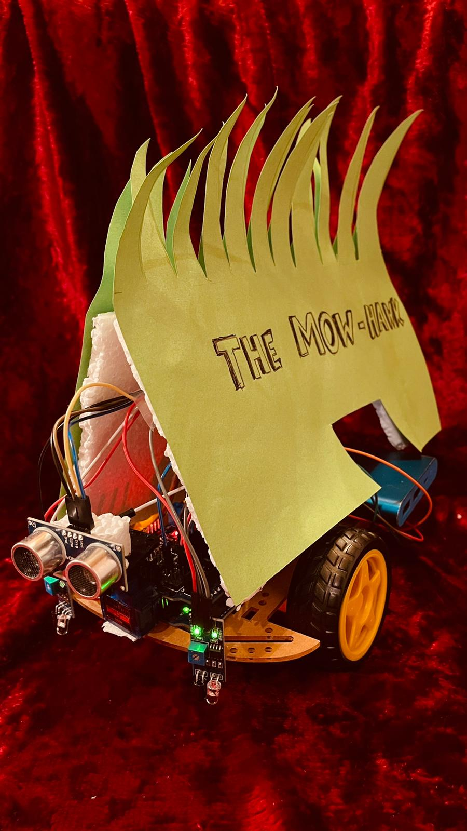
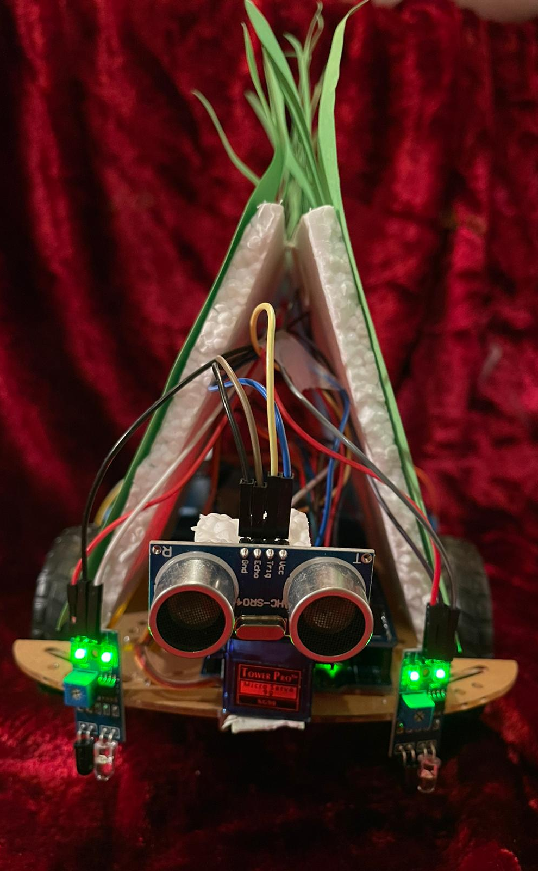
THE Mow-hawk
To style your lawn MowAliciously
Vedhashruthi Harinath – 3302834
Aadithya Ramamurthy – 3304090

Slide 2

INDEX
Tasks completed
Component List
Web Interface
Video Demonstration
Timeline

Slide 3

Tasks COMPLETED
Simple and easy to build and use.
Covers the pre-defined Arena.
Detects and avoids any obstacles during its operation.
Detects the boundary and edges and stays within it .
Returns to the charging station when battery is low by line following.
User-friendly Web interface to operate the mower manually or autonomously.

Slide 4

Looks LIKE SOUNDS Like
COMPONENT LIST | Qty
Arduino Uno | 1
V5 Shield | 1
ESP32 | 1
Motor driver L298N | 1
IR sensors | 2
DC Motors | 2
Ultrasonic Sensor | 1
Plastic Base | 1
Wheels | 3
Ingress Protection Cover | 1

Slide 5
COMPONENT LIST | Type
Screws | M3
Nuts | M3
Screw Long | M3
Spacer | M3
Cables | Male-Female
Cables | Female-Female
Cables | Male-Male
4 double AA Batteries | 1.5 V
Power Bank | 5 V

Slide 6
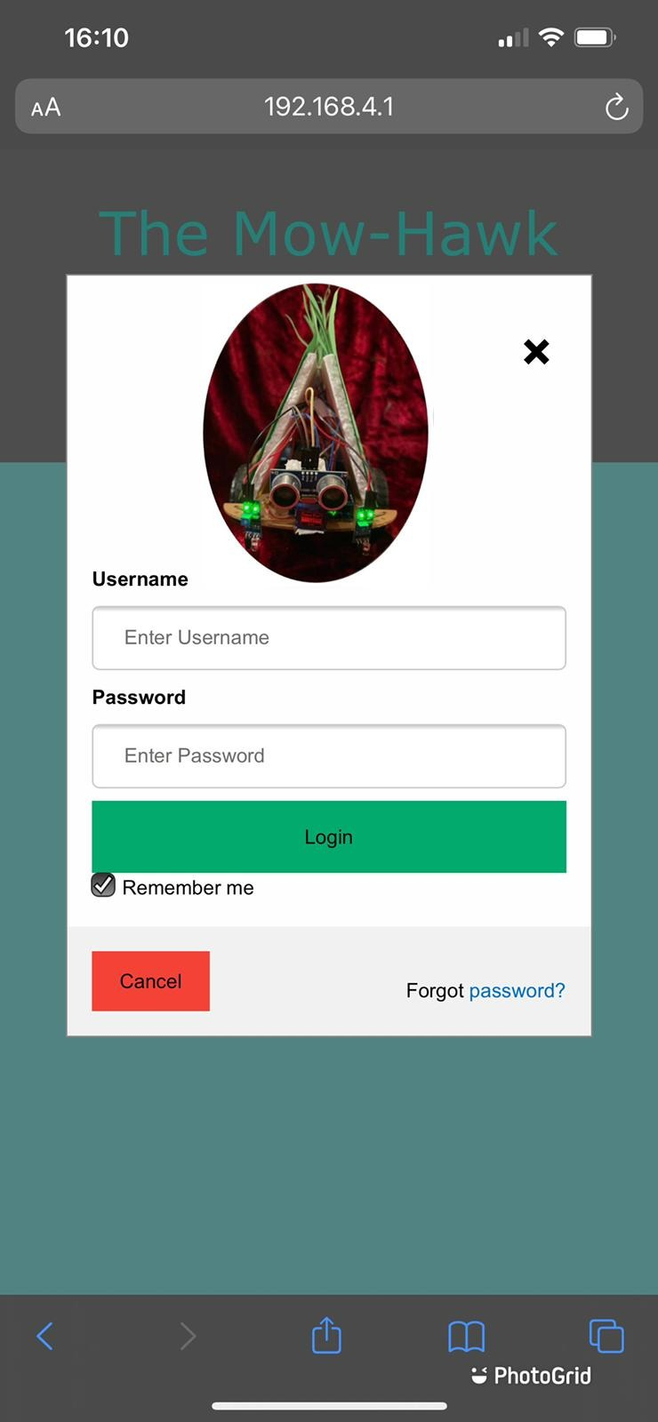
Login page
Power on-off
Manual – auto mode
Directional Buttons on the manual mode
Emergency Stop
Scheduling and time log of the operation
Battery level indication
WEB INTERFACE

Slide 7
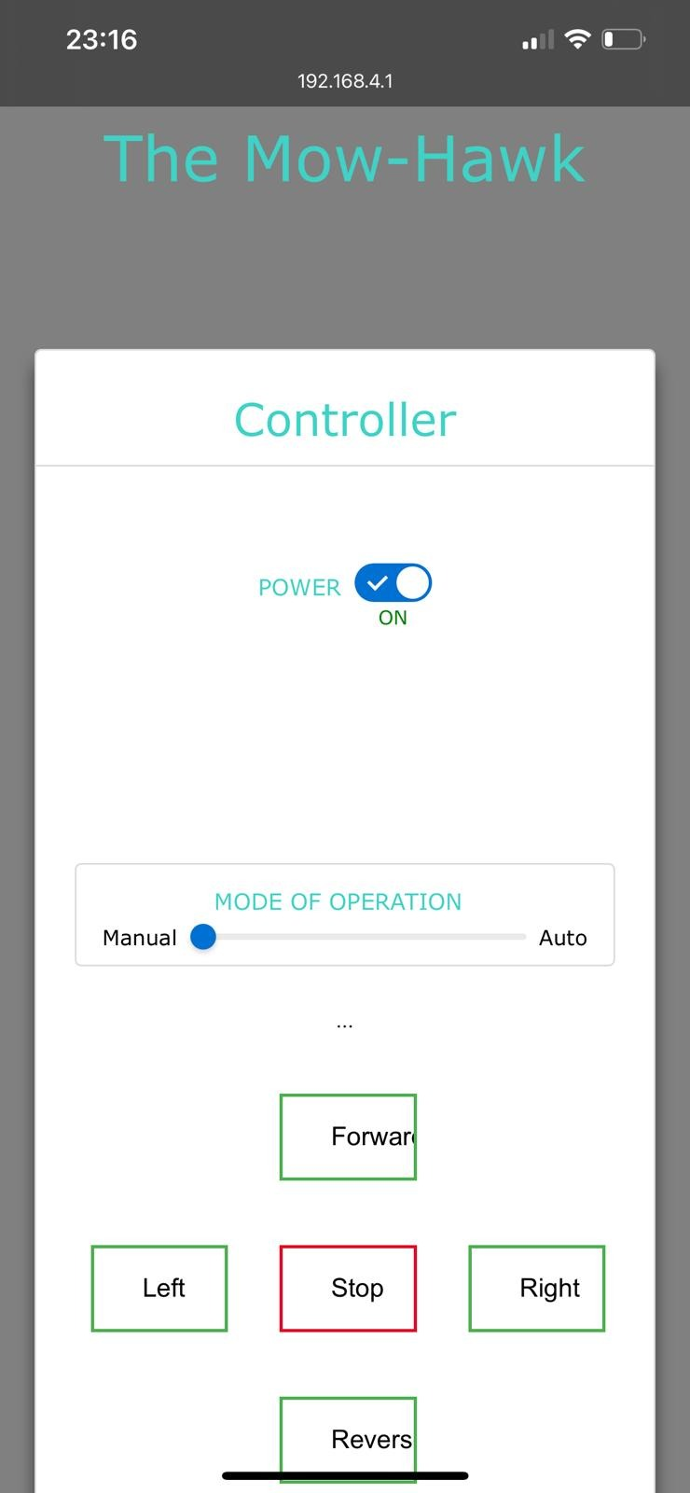
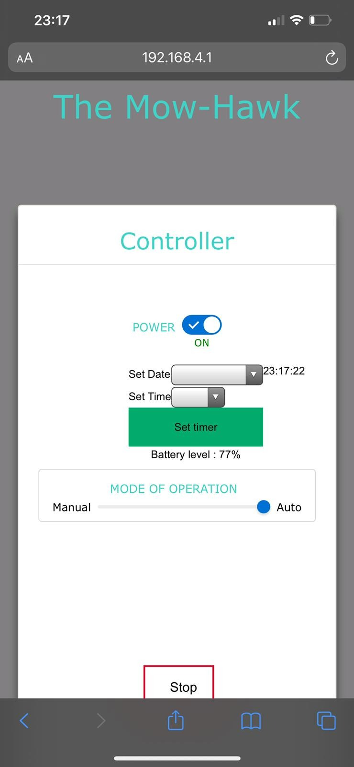
On phone

Slide 8
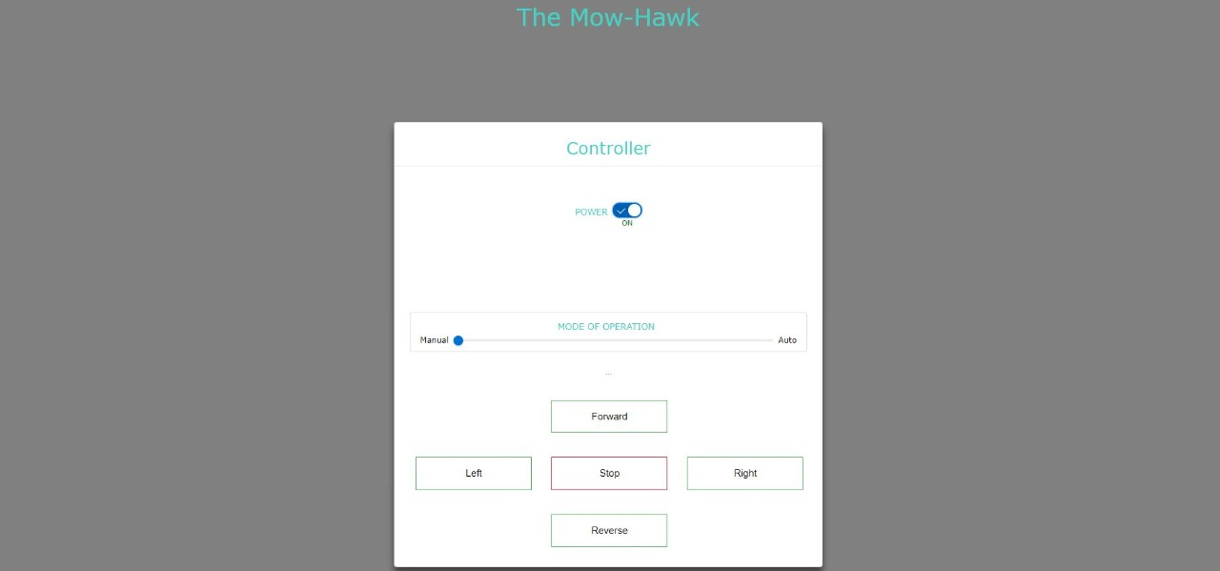
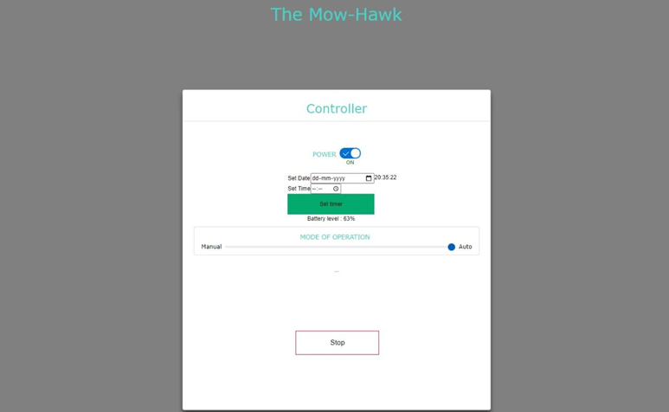
On desktop

Slide 9
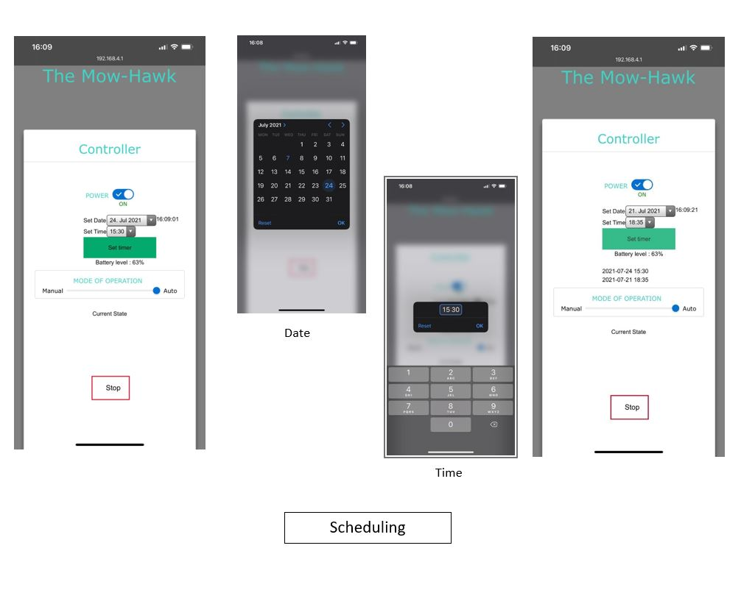
SCHEDULING AND TIME LOG

Slide 10


Video demonstration

Slide 11


Slide 12
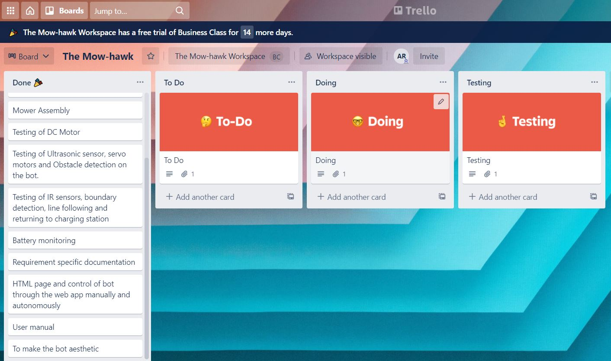
TIMELINE on Trello board

Slide 13
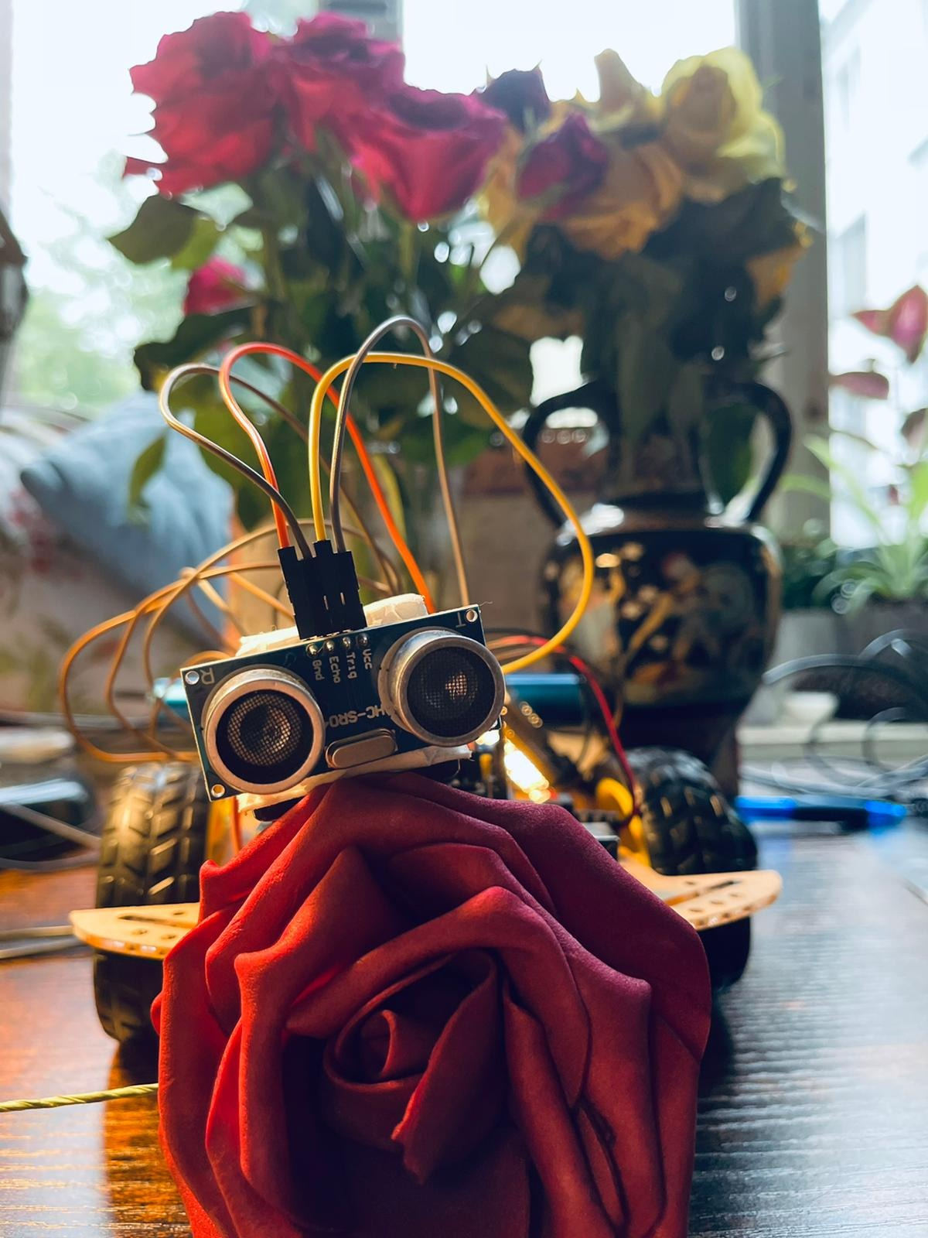
Thank you !

